Slide 1
Learning intentions and success criteria
I am learning…
I can…
About the design stage of software development
How to read and create pseudocode
Describe the design phase and the aspects of software analysis
Design pseudocode according to a program specification

Slide 2
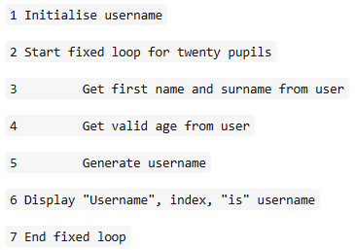
Introduction
Pseudocode is an informal high-level description of the of a computer program:
It uses the structural conventions of a programming language but is intended for human reading and so uses words similar to English
Pseudocode is programming language independent meaning it doesn’t shouldn’t use syntax from a specific language

Slide 3

Features of Pseudocode
Describes in detail the steps required to carry out the program without the need for a specified programming language
Shows the control constructs of the algorithm i.e. Loops, Conditions, etc
Breaks the problem down into simpler more manageable steps.

Slide 4
Basic Example
A program is to be created that calculates the volume of a cuboid.
Using Pseudocode, create a design for this solution.
Analysis
Input: Length, Breadth, Height
Process: Calculate volume (l*b*h)
Output: Display volume
Pseudocode
1 GET length from KEYBOARD
2 GET breadth from KEYBOARD
3 GET height from KEYBOARD
4 volume = length*breadth*height
5 SEND volume to DISPLAY

Slide 5
Condition Example
This program will enter a pupil’s name and test score.
It will then check if its 50 marks or more to determine if the pupil has passed the test or not and display the result.
Analysis
Input: Name, Score
Process: Check if test score is 50 or more to find result.
Output: Display result
Pseudocode
1 GET name from KEYBOARD
2 GET score from KEYBOARD
3 IF score >= 50 THEN
4 result = “Test passed”
5 ELSE
6 result = “Test failed”
7 END IF
8 SEND result to DISPLAY

Slide 6
Loop Example
John wants to create a program to calculate his total tips from his job in the last 4 weeks. He gets his tips once per week.
A month is considered good for tips if £100 or more is made.
Analysis
Input: Weekly tips (4 times)
Process:
Add weekly tips to total
Calculate if total is 100 or greater
Output: Display result
Pseudocode
1 LOOP 4 TIMES
2 GET weekly_tip from KEYBOARD
3 total = total + weekly_tip
4 END LOOP
3 IF total >= 100 THEN
4 SEND “Good month” to DISPLAY
5 ELSE
6 SEND “Bad month” to DISPLAY
7 END IF

Slide 7
Learning intentions and success criteria
I am learning…
I can…
About the design stage of software development
How to read and create structure diagrams
Describe the design phase and the aspects of software analysis
Design structure diagrams according to a program specification

